Slide 1
Murach’s PHP and MySQL (4th Edition)
Chapter 20
A database-driven website

Slide 2
Objectives
Applied
Develop database-driven websites using any of the skills in this chapter or this section.
Knowledge
Describe the use of a content management system for a database-driven application.
Describe the use of include files and the include path.
Describe the directory structure for a database-driven website.

Slide 3
The text that’s entered by the user
The Fender Stratocaster is <i>the</i> electric guitar design that changed the world. This guitar features a thicker bridge block for increased sustain and a more stable point of contact with the strings.
Features:
* Thicker bridge block
* 3-ply parchment pick guard
* Tinted neck

Slide 4
The HTML that’s generated by the system
<p>The Fender Stratocaster is <i>the</i> electric guitar design that changed the world. This guitar features a thicker bridge block for increased sustain and a more stable point of contact with the strings.</p>
<p>Features:</p>
<ul>
<li>Thicker bridge block</li>
<li>3-ply parchment pick guard</li>
<li>Tinted neck</li>
</ul>

Slide 5
The rules for this content management system
Use two returns to start a new paragraph.
Use an asterisk to mark items in a bulleted list.
Use one return between items in a bulleted list.
Use standard HMTL tags for bold and italics.

Slide 6
The util/tags.php file (part 1)
<?php
function add_tags($text) {
// Convert return characters to the Unix new lines
// Convert Windows characters
$text = str_replace("\r\n", "\n", $text);
// Convert macOS characters
$text = str_replace("\r", "\n", $text);
// Get an array of paragraphs
$paragraphs = explode("\n\n", $text);

Slide 7
The util/tags.php file (part 2)
// Add tags to each paragraph
$text = '';
foreach($paragraphs as $p) {
$p = ltrim($p);
$first_char = substr($p, 0, 1);
if ($first_char == '*') {
// Add <ul> and <li> tags
$p = '<ul>' . $p . '</li></ul>';
$p = str_replace("*", '<li>', $p);
$p = str_replace("\n", '</li>', $p);
} else {
// Add <p> tags
$p = '<p>' . $p . '</p>';
}
$text .= $p;
}
return $text;
}

Slide 8
The util/tags.php file (part 3)
function get_first_paragraph($text) {
$text_with_tags = add_tags($text);
$i = strpos($text_with_tags, "</p>");
return substr($text_with_tags, 3, $i-3);
}
?>

Slide 9
Code statements that use the tag functions
$description_with_tags =
add_tags($product->getDescription());
echo get_first_paragraph($product->getDescription());

Slide 10
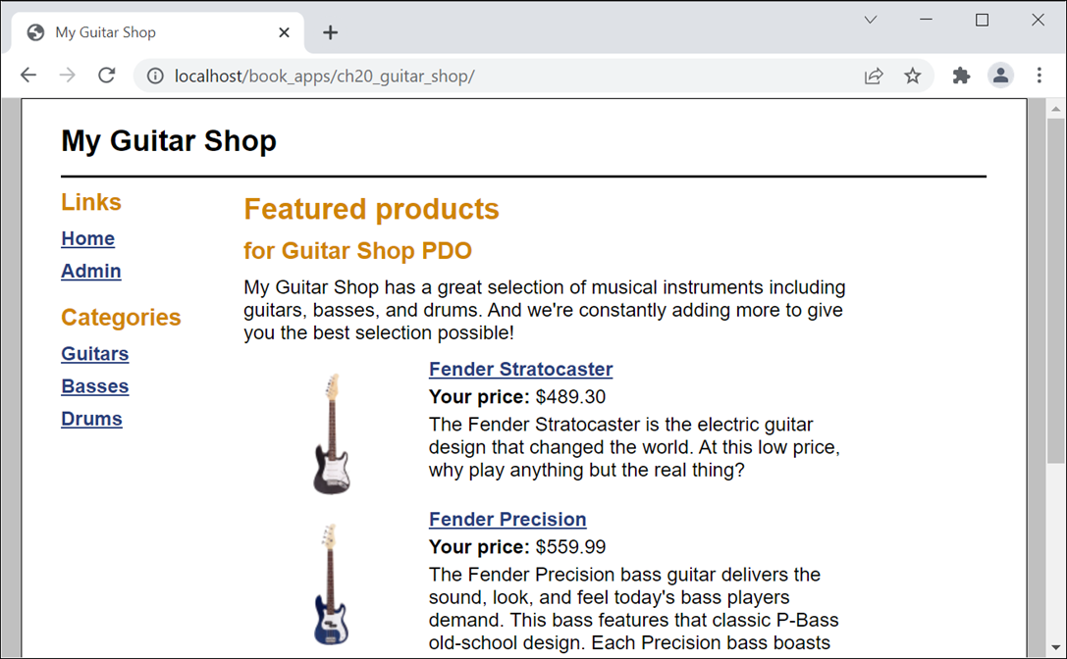
The Home page for the Guitar Shop website

Slide 11
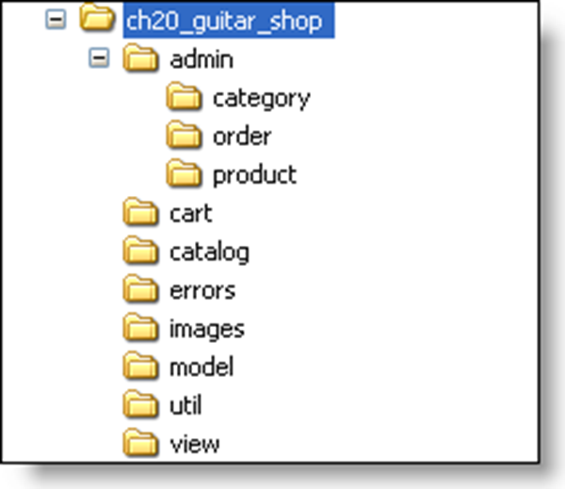
The directory structure for the website starting from htdocs/book_apps

Slide 12
Files in the application’s root directory
index.php
home_view.php
main.css

Slide 13
The util/main.php file
<?php
// Get the document root
$doc_root = filter_input(INPUT_SERVER, 'DOCUMENT_ROOT');
// Get the application path
$uri = filter_input(INPUT_SERVER, 'REQUEST_URI');
$dirs = explode('/', $uri);
$app_path = '/' . $dirs[1] . '/' . $dirs[2] . '/';
// Set the include path
set_include_path($doc_root . $app_path);
?>

Slide 14
The view/header.php file
<!DOCTYPE html>
<html>
<!-- the head section -->
<head>
<title>My Guitar Shop</title>
<link rel="stylesheet"
href="<?php echo $app_path ?>main.css" />
</head>
<!-- the body section -->
<body>
<header>
<h1>My Guitar Shop</h1>
</header>
<main>

Slide 15
The view/sidebar.php file (part 1)
<aside>
<!-- These links are for testing only.
Remove them from a production application. -->
<h2>Links</h2>
<ul>
<li>
<a href="<?php echo $app_path; ?>">Home</a>
</li>
<li>
<a href="<?php echo $app_path . 'admin'; ?>">
Admin</a>
</li>
</ul>

Slide 16
The view/sidebar.php file (part 2)
<h2>Categories</h2>
<ul>
<!-- display links for all categories -->
<?php foreach ($categories as $category) : ?>
<li>
<a href="<?php echo $app_path . 'catalog' .
'?action=list_products' .
'&amp;category_id=' .
$category->getID(); ?>">
<?php echo $category->getName(); ?>
</a>
</li>
<?php endforeach; ?>
<li>&nbsp;</li>
</ul>
</aside>

Slide 17
The view/sidebar_admin.php file (part 1)
<aside>
<h2>Links</h2>
<ul>
<li>
<a href="<?php echo $app_path; ?>">Home</a>
</li>
<li>
<a href="<?php echo $app_path . 'admin'; ?>">
Admin</a>
</li>
</ul>

Slide 18
The view/sidebar_admin.php file (part 2)
<h2>Categories</h2>
<ul>
<!-- display links for all categories -->
<?php foreach ($categories as $category) : ?>
<li>
<a href="<?php echo $app_path .
'admin/product' .
'?action=list_products' .
'&amp;category_id=' .
$category->getID(); ?>">
<?php echo $category->getName(); ?>
</a>
</li>
<?php endforeach; ?>
</ul>
</aside>

Slide 19
Three methods of the model/product.php file
public function getImageFilename() {
$image_filename = $this->code . '_m.png';
return $image_filename;
}
public function getImagePath(string $app_path) {
$image_path = $app_path . 'images/' .
$this->getImageFilename();
return $image_path;
}
public function getImageAltText() {
$image_alt = 'Image: ' . $this->getImageFilename();
return $image_alt;
}

Slide 20
The view/product.php file (part 1)
<h1><?php echo $product->getName(); ?></h1>
<div id="left_column">
<p><img src="<?php
echo $product->getImagePath($app_path); ?>"
alt="<?php
echo $product->getImageAltText(); ?>" /></p>
</div>
<div id="right_column">
<p><b>List Price:</b>
<?php echo '$' . $product->getPrice(); ?></p>
<p><b>Discount:</b>
<?php echo
$product->getDiscountPercentFormatted() . '%'; ?></p>
<p><b>Your Price:</b>
<?php echo '$' .
$product->getDiscountPriceFormatted(); ?>
(You save <?php echo '$' .
$product->getDiscountAmountFormatted(); ?>)</p>

Slide 21
The view/product.php file (part 2)
<form action="<?php echo $app_path . 'cart' ?>"
method="post">
<input type="hidden" name="action" value="add">
<input type="hidden" name="product_id"
value="<?php echo $product->getID(); ?>">
<b>Quantity:</b>
<input type="text" name="quantity" value="1"
size="2">
<input type="submit" value="Add to Cart">
</form>
<h2 class="no_bottom_margin">Description</h2>
<?php echo add_tags($product->getDescription()); ?>
</div>

Slide 22
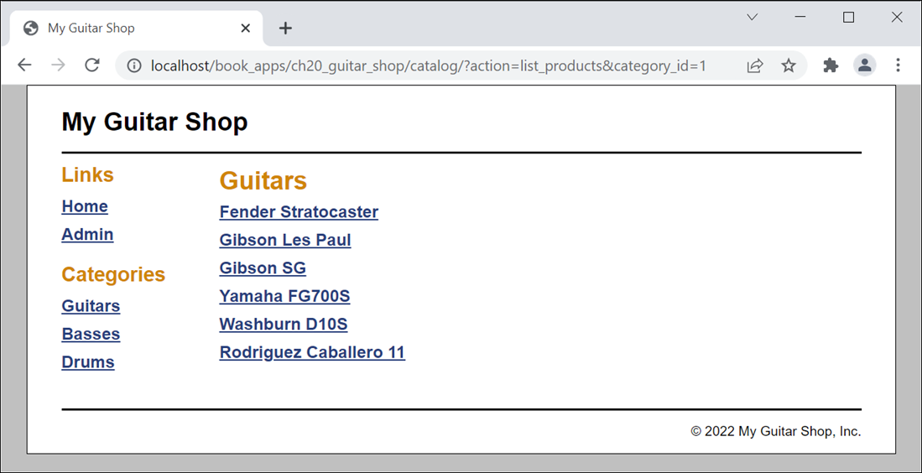
Product List page: Product Catalog application

Slide 23
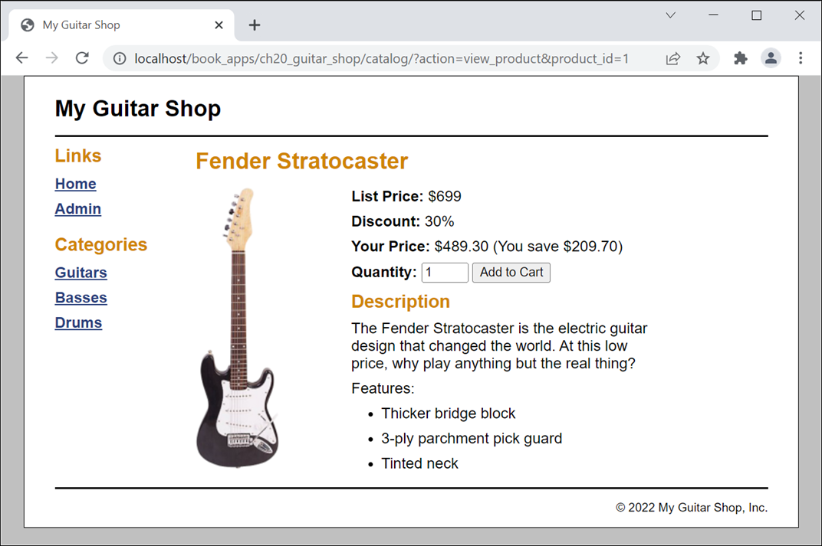
Product View page: Product Catalog application

Slide 24
The catalog/index.php file (part 1)
<?php
require_once('../util/main.php');
require_once('../util/tags.php');
require_once('../model/database.php');
require_once('../model/product_db.php');
require_once('../model/category_db.php');
require_once('../model/product.php');
require_once('../model/category.php');
$action = filter_input(INPUT_POST, 'action');
if ($action == NULL) {
$action = filter_input(INPUT_GET, 'action');
if ($action == NULL) {
$action = 'list_products';
}
}

Slide 25
The catalog/index.php file (part 2)
switch ($action) {
case 'list_products':
// get current category
$category_id = filter_input(INPUT_GET,
'category_id', FILTER_VALIDATE_INT);
if ($category_id == NULL ||
$category_id === FALSE) {
$category_id = 1;
}
// get categories and products
$current_category =
CategoryDB::getCategory($category_id);
$categories = CategoryDB::getCategories();
$products =
ProductDB::getProductsByCategory($category_id);
// display view
include('product_list.php');
break;

Slide 26
The catalog/index.php file (part 3)
case 'view_product':
$categories = CategoryDB::getCategories();
// get product data
$product_id = filter_input(INPUT_GET, 'product_id',
FILTER_VALIDATE_INT);
$product = ProductDB::getProduct($product_id);
// display product
include('product_view.php');
break;
}
?>

Slide 27
The catalog/product_list.php file
<?php include '../view/header.php'; ?>
<?php include '../view/sidebar.php'; ?>
<section>
<h1><?php echo $current_category->getName(); ?></h1>
<?php if (count($products) == 0) : ?>
<ul><li>There are no products in this category.</li></ul>
<?php else: ?>
<ul>
<?php foreach ($products as $product) : ?>
<li>
<a href="?action=view_product&amp;product_id=<?php
echo $product->getID(); ?>">
<?php echo $product->getName(); ?>
</a>
</li>
<?php endforeach; ?>
</ul>
<?php endif; ?>
</section>
<?php include '../view/footer.php'; ?>

Slide 28
The catalog/product_view.php file
<?php include '../view/header.php'; ?>
<?php include '../view/sidebar.php'; ?>
<section>
<!-- display product -->
<?php include '../view/product.php'; ?>
</section>
<?php include '../view/footer.php'; ?>

Slide 29
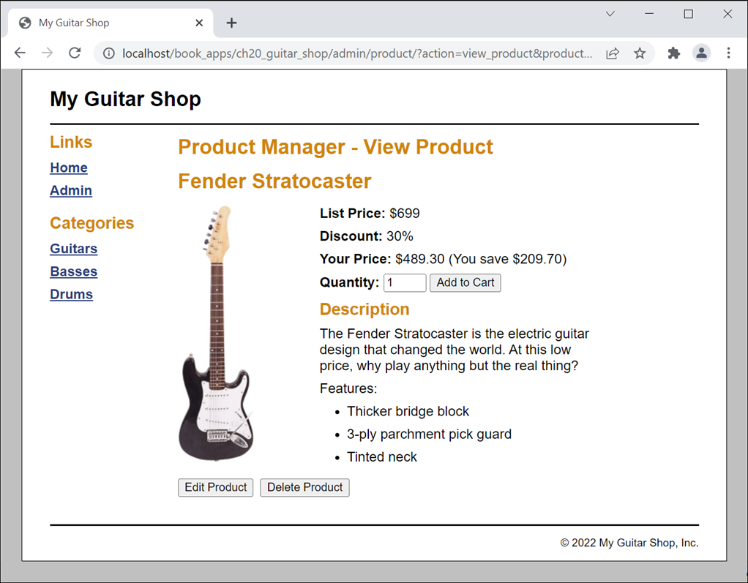
Product View page: Product Manager application

Slide 30
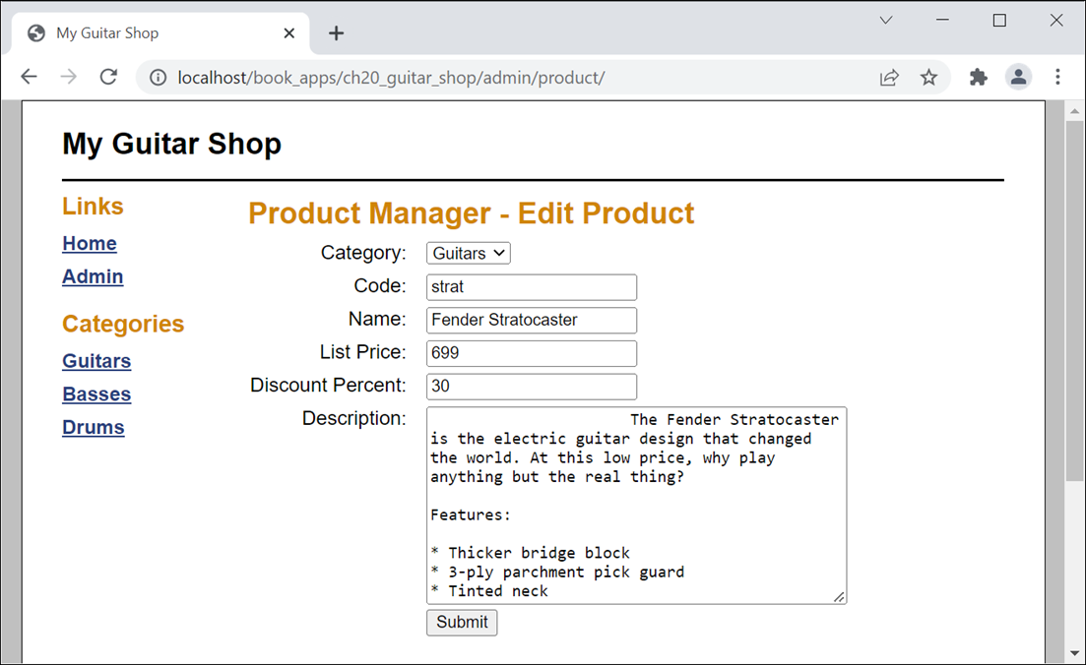
Product Add/Edit page: Product Manager app

Slide 31
The admin/product/index.php file (part 1)
<?php
require_once('../../util/main.php');
require_once('../../util/tags.php');
require_once('../../model/database.php');
require_once('../../model/product_db.php');
require_once('../../model/category_db.php');
require_once('../../model/product.php');
require_once('../../model/category.php');
$action = filter_input(INPUT_POST, 'action');
if ($action == NULL) {
$action = filter_input(INPUT_GET, 'action');
if ($action == NULL) {
$action = 'list_products';
}
}

Slide 32
The admin/product/index.php file (part 2)
switch ($action) {
case 'list_products':
$category_id = filter_input(INPUT_GET,
'category_id', FILTER_VALIDATE_INT);
if ($category_id === FALSE ||
$category_id === NULL) {
$category_id = 1;
}
$categories = CategoryDB::getCategories();
$current_category =
CategoryDB::getCategory($category_id);
$products =
ProductDB::getProductsByCategory($category_id);
include('product_list.php');
break;
case 'view_product':
$categories = CategoryDB::getCategories();
$product_id = filter_input(INPUT_GET, 'product_id',
FILTER_VALIDATE_INT);
$product = ProductDB::getProduct($product_id);
include('product_view.php');
break;

Slide 33
The admin/product/index.php file (part 3)
case 'delete_product':
$product_id = filter_input(INPUT_POST,
'product_id', FILTER_VALIDATE_INT);
$category_id = filter_input(INPUT_POST,
'category_id', FILTER_VALIDATE_INT);
ProductDB::deleteProduct($product_id);
header("Location: .?category_id=$category_id");
break;
case 'show_add_edit_form':
$categories = CategoryDB::getCategories();
$product_id = filter_input(INPUT_GET, 'product_id',
FILTER_VALIDATE_INT);
if ($product_id == NULL) {
$product_id = filter_input(INPUT_POST,
'product_id', FILTER_VALIDATE_INT);
}
if (isset($product_id)) {
$product = ProductDB::getProduct($product_id);
}
include('product_add_edit.php');
break;

Slide 34
The admin/product/index.php file (part 4)
case 'add_product':
$category_id = filter_input(INPUT_POST,
'category_id', FILTER_VALIDATE_INT);
$code = filter_input(INPUT_POST, 'code');
$name = filter_input(INPUT_POST, 'name');
$description = filter_input(INPUT_POST,
'description');
$price = filter_input(INPUT_POST, 'price',
FILTER_VALIDATE_FLOAT);
$discount_percent = filter_input(
INPUT_POST, 'discount_percent',
FILTER_VALIDATE_FLOAT);

Slide 35
The admin/product/index.php file (part 5)
if ($category_id === FALSE ||
$code == NULL || $name == NULL ||
$description == NULL ||
$price === FALSE ||
$discount_percent === FALSE) {
$error = 'Invalid product data.
Check all fields and try again.';
include('../../errors/error.php');
} else {
$category = new Category($category_id, "");
$product = new Product($category, $code,
$name, $description, $price,
$discount_percent);
$product_id =
ProductDB::addProduct($product);
// display added product
header("Location:
.?action=view_product&product_id=$product_id");
}
break;

Slide 36
The admin/product/index.php file (part 6)
case 'update_product':
$product_id = filter_input(INPUT_POST, 'product_id',
FILTER_VALIDATE_INT);
$category_id = filter_input(INPUT_POST, 'category_id',
FILTER_VALIDATE_INT);
$code = filter_input(INPUT_POST, 'code');
$name = filter_input(INPUT_POST, 'name');
$description = filter_input(INPUT_POST, 'description');
$price = filter_input(INPUT_POST, 'price',
FILTER_VALIDATE_FLOAT);
$discount_percent = filter_input(INPUT_POST,
'discount_percent');

Slide 37
The admin/product/index.php file (part 7)
if ($product_id === FALSE || $category_id === FALSE ||
$code == NULL || $name == NULL ||
$description == NULL || $price === FALSE ||
$discount_percent === FALSE) {
$error = 'Invalid product data.
Check all fields and try again.';
include('../../errors/error.php');
} else {
$category = new Category($category_id, "");
$product = new Product($category, $code, $name,
$description, $price, $discount_percent);
$product->setID($product_id);
ProductDB::updateProduct($product);
// display updated product
header("Location:
.?action=view_product&product_id=$product_id");
}
break;
}
?>

Slide 38
The admin/product/product_view.php file (part 1)
<?php include '../../view/header.php'; ?>
<?php include '../../view/sidebar_admin.php'; ?>
<section>
<h1>Product Manager - View Product</h1>
<!-- display product -->
<?php include '../../view/product.php'; ?>
<!-- display buttons -->
<div class="last_paragraph">
<form action="." method="post"
id="edit_button_form">
<input type="hidden" name="action"
value="show_add_edit_form"/>
<input type="hidden" name="product_id"
value="<?php echo $product->getID(); ?>" />
<input type="hidden" name="category_id"
value="<?php
echo $product->getCategory()->getID(); ?>" />
<input type="submit" value="Edit Product" />
</form>

Slide 39
The admin/product/product_view.php file (part 2)
<form action="." method="post" >
<input type="hidden" name="action"
value="delete_product"/>
<input type="hidden" name="product_id"
value="<?php echo $product->getID(); ?>" />
<input type="hidden" name="category_id"
value="<?php
echo $product->getCategory()->getID(); ?>" />
<input type="submit" value="Delete Product"/>
</form>
</div>
</section>
<?php include '../../view/footer.php';

Slide 40
The admin/product/product_add_edit.php file (part 1)
<?php include '../../view/header.php'; ?>
<?php include '../../view/sidebar_admin.php'; ?>
<?php
if (isset($product)) {
$heading_text = 'Edit Product';
$action = 'update_product';
$category_id = $product->getCategory()->getID();
$code = htmlspecialchars($product->getCode());
$name = htmlspecialchars($product->getName());
$price = $product->getPrice();
$discount = $product->getDiscountPercent();
$description =
htmlspecialchars($product->getDescription());

Slide 41
The product_add_edit.php file (part 2)
} else {
$heading_text = 'Add Product';
$action = 'add_product';
$category_id = '';
$code = '';
$name = '';
$price = '';
$discount = '';
$description = '';
}
?>

Slide 42
The product_add_edit.php file (part 3)
<section>
<h1>Product Manager - <?php echo $heading_text; ?></h1>
<form action="index.php" method="post"
id="add_edit_product_form">
<input type="hidden" name="action"
value="<?php echo $action; ?>" />
<input type="hidden" name="category_id"
value="<?php echo $category_id; ?>" />
<input type="hidden" name="product_id"
value="<?php echo $product_id; ?>" />
<label>Category:</label>
<select name="category_id">
<?php foreach ($categories as $category) :
$selected = '';
if ($category->getID() == $category_id) {
$selected = 'selected';
}
?>

Slide 43
The product_add_edit.php file (part 4)
<option value="<?php
echo $category->getID(); ?>"
<?php echo $selected; ?>>
<?php echo $category->getName(); ?>
</option>
<?php endforeach; ?>
</select><br>
<label>Code:</label>
<input type="text" name="code"
value="<?php echo $code; ?>"><br>
<label>Name:</label>
<input type="text" name="name"
value="<?php echo $name; ?>"><br>
<label>List Price:</label>
<input type="text" name="price"
value="<?php echo $price; ?>"><br>

Slide 44
The product_add_edit.php file (part 5)
<label>Discount Percent:</label>
<input type="text" name="discount_percent"
value="<?php echo $discount; ?>"><br>
<label>Description:</label>
<textarea name="description" rows="10">
<?php echo $description; ?></textarea><br>
<label>&nbsp;</label>
<input type="submit" value="Submit">
</form>

Slide 45
The product_add_edit.php file (part 6)
<div id="formatting_directions">
<h2>How to format the Description entry</h2>
<ul>
<li>Use two returns to start a new
paragraph.</li>
<li>Use an asterisk to mark items in a bulleted
list.</li>
<li>Use one return between items in a bulleted
list.</li>
<li>Use standard HMTL tags for bold and
italics.</li>
</ul>
</div>
</section>
<?php include '../../view/footer.php'; ?>

